Slide 1

Where Are The Drugs?
By Phillip Vargas

Slide 2


SOURCES
Google Cloud Platform: Medications Table
https://console.cloud.google.com/bigquery?project=bold-lantern-272703&folder=&organizationId=&p=bigquery-public-data&d=cms_medicare&t=physicians_and_other_supplier_2015&page=table
Census.gov: Population Table
https://www.census.gov/data/tables/time-series/demo/popest/2010s-state-total.html#par_textimage_1574439295
Census.gov: Demographic Table
https://www.census.gov/data/tables/time-series/demo/popest/2010s-state-detail.html#par_textimage_785300169

Slide 3
EDA OUTLINE
Preview data
Check total number of entries and column types
Check any null values
Check duplicate entries
Plot distribution of numeric data (univariate and pairwise joint distribution)
Plot count distribution of categorical data
Analyze time series of numeric data by daily, monthly and yearly frequencies

Slide 4
Hypothesis Testing Process
Setup
Take a Skeptical Stance, and Clearly State This Hypothesis
Create a Probabilistic Model of the Situation Assuming the Null Hypothesis is True
Decide how certain You Need to Be to Reject Your Skeptical Assumption
Collect Your Data
Calculate the Probability of Finding a Result Equally or More Extreme than Actually Observed

Slide 5
Setup
Medicare is a national health insurance program in the United States, begun in 1966 under the Social Security Administration and now administered by the Centers for Medicare and Medicaid Services (CMS).
In 2014 the CMS had 1.2 billion claims for medication prescriptions.
In 2014 the census estimated the United States population to be 318 million people
Does population demographics effect medication prescriptions?

Slide 6
Take a Skeptical Stance, and Clearly State This Hypothesis
Null Hypothesis
Alternate Hypothesis
There is no significant difference in medication prescriptions based on population demographics.
There is a significant difference in medication prescriptions based on population demographics.

Slide 7
Create a Probabilistic Model of the Situation Assuming the Null Hypothesis is True
Drug of Focus:
LEVOTHYROXINE SODIUM
This treats hyperthyroidism
Demographic of Focus:
Gender population percentage
Drugs are ranked 1 to 5
5 being highest total claims in state
1 being lowest total claims in state
NULL: There is no correlation between LEVOTHYROXINE SODIUM and gender population percentage

Slide 8
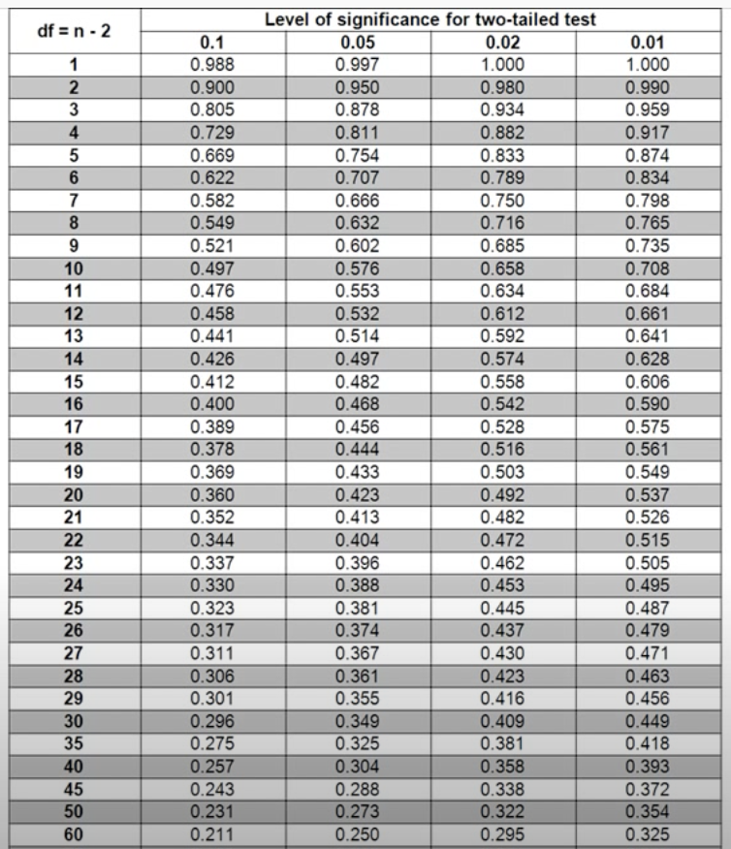
Decide how certain You Need to Be to Reject Your Skeptical Assumption
Choosing a 99% confidence interval
Alpha = .01

Slide 9
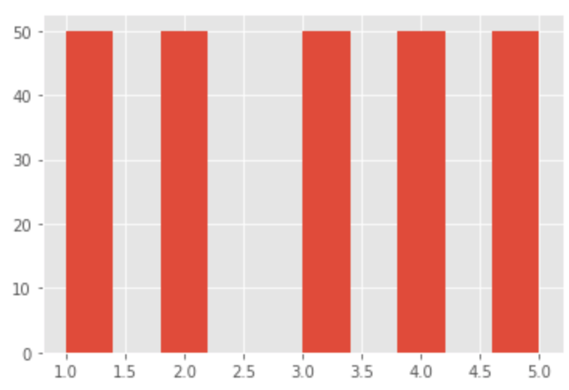
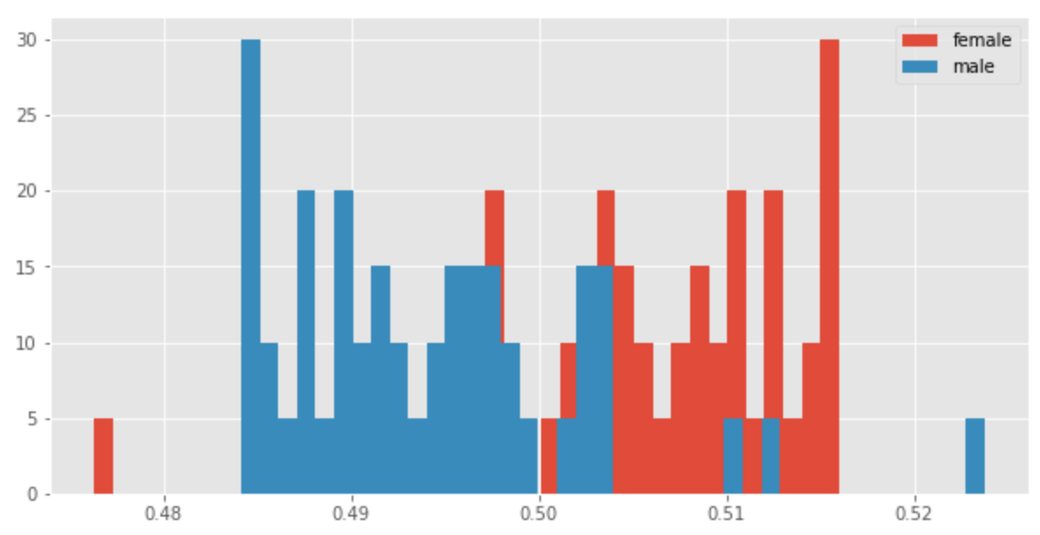
Collect Your Data
GENDER Distribution
ROW RANK Distribution

Slide 10
Calculate the Probability of Finding a Result Equally or More Extreme than Actually Observed
Spearman Correlation r-test
Define Null and Alternative Hypotheses
State Alpha
Calculate Degrees of Freedom
State Decision Rule
Calculate Test Statistic
State Results
State Conclusion
There is NO relationship between gender and drug rank for drug LEVOTHYROXINE SODIUM
Alpha = .01
DOF = 47-2= 45
If r > .372, then REJECT Null
r(45) = .433
r(45) = .433 > .372; REJECT NULL
There is a correlation with 99% CI
https://www.youtube.com/watch?v=rR-jptLvhFw

Slide 11
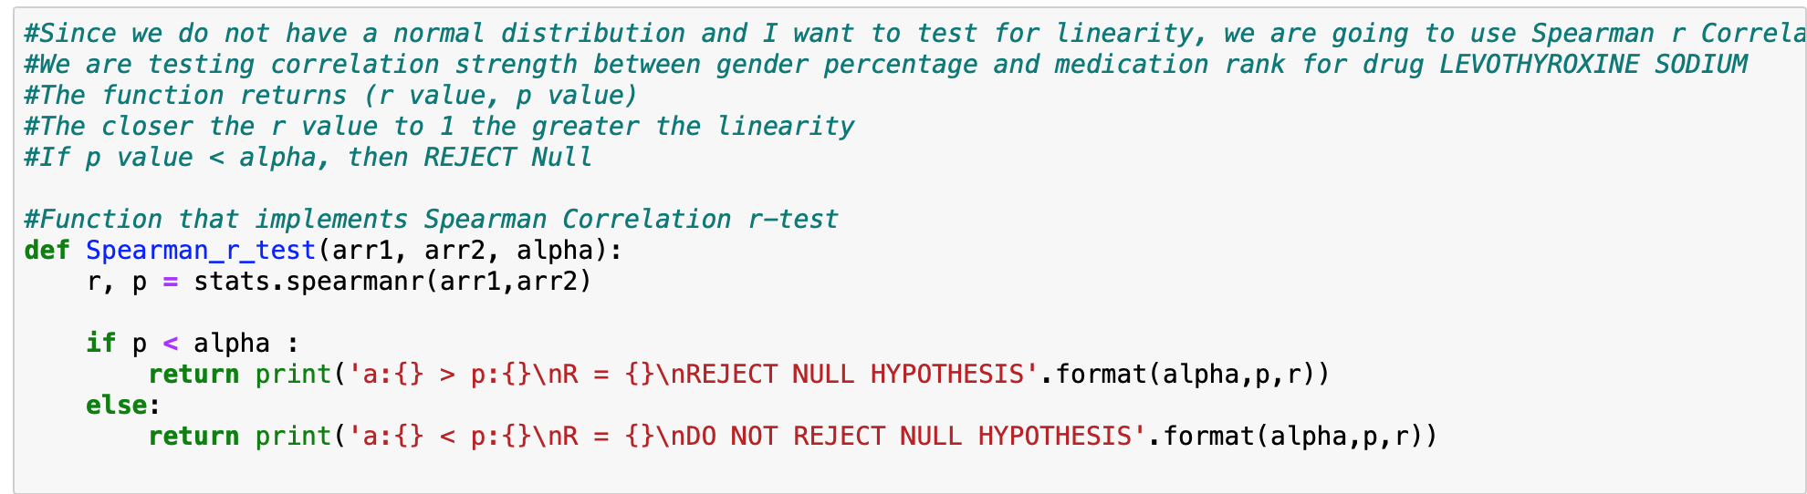
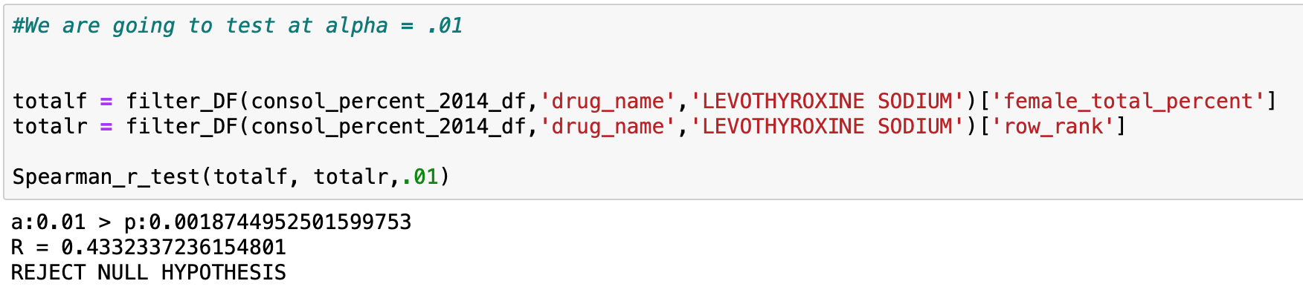
PYTHON: Spearman Correlation r-test

Slide 12
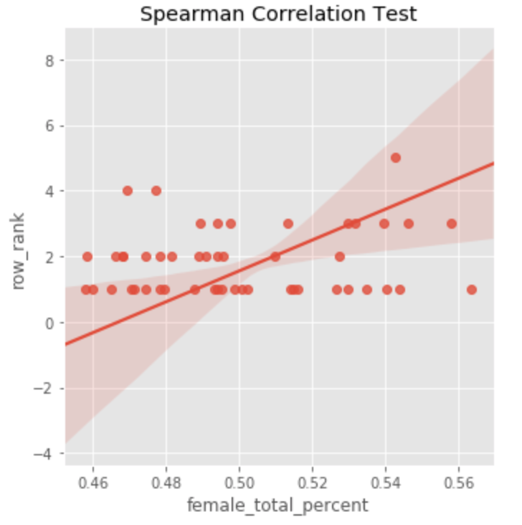
Lets view this test graphically

Slide 13

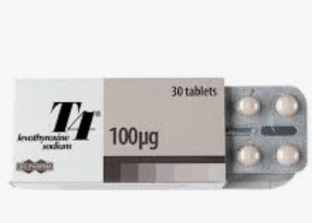
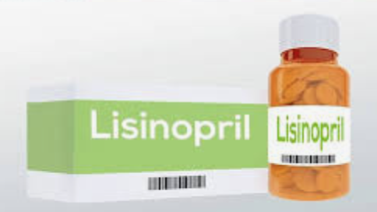
LETS COMPARE DRUGS!!
LEVOTHYROXINE SODIUM:
Treats Hyperthyroidism
LISINOPRIL:
Treats High Blood Pressure

Slide 14
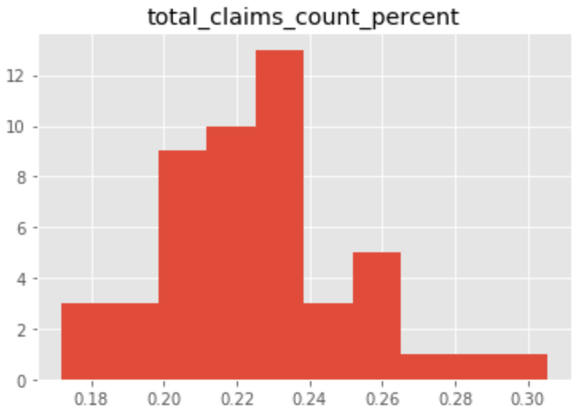
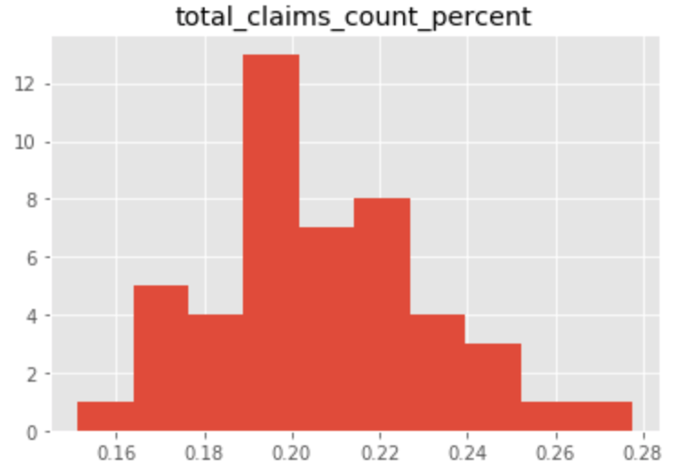
Distributions
LEVOTHYROXINE SODIUM
LISINOPRIL

Slide 15
Hypothesis Testing with Welch's t-test
Define Null and Alternative Hypotheses
State Alpha
State Decision Rule
Calculate Test Statistic
State Results
State Conclusion
There is NO significant difference in claims percentage between the drugs LEVOTHYROXINE SODIUM and LISINOPRIL
Alpha = .01
If pval < alpha, then REJECT Null
pval = .0007
pval = .0007 < .01; REJECT NULL
With a 99% CI There is a significant difference
https://www.youtube.com/watch?v=rR-jptLvhFw

Slide 16
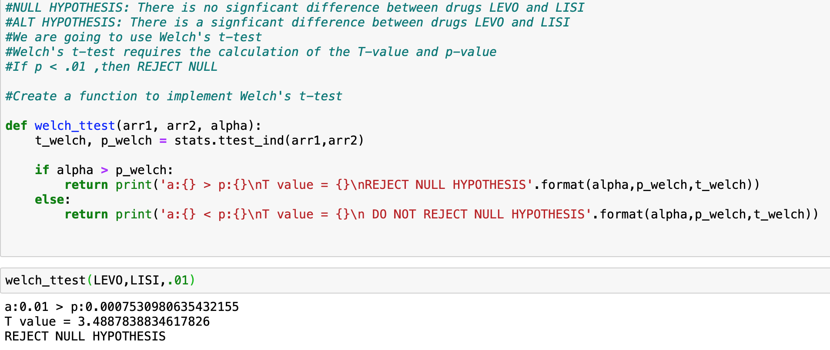
PYTHON: Welch’s t-test

Slide 17
